Slide 1
Special topics Topic6:
Life Cycle Nutrition:
Pregnancy and Lactation
Reference: understanding normal and clinical nutrition, 9th ed, chapter:14

Slide 2
Nutrition prior to Pregnancy
Achieve and maintain a healthy body weight. Both underweight and overweight are associated with infertility. Overweight and obese men have low sperm counts and hormonal changes that reduce fertility.
Excess body fat in women disrupts menstrual regularity and ovarian hormone production. Should a pregnancy occur, mothers, both underweight and overweight, and their newborns, face increased risks of complications.

Slide 3
2. Choose an adequate and balanced diet. Malnutrition reduces fertility and impairs the early development of an infant should a woman become pregnant.
In contrast, a healthy diet that emphasizes monounsaturated fats instead of trans fats, vegetable proteins instead of animal proteins, and low glycemic carbohydrates instead of simple sugars can favorably influence fertility.
Men with diets rich in antioxidant nutrients have higher sperm numbers and motility

Slide 4
3. Be physically active. A woman who wants to be physically active when she is pregnant needs to become physically active beforehand.
4. Receive regular medical care. Regular health-care visits can help ensure a healthy start to pregnancy.
5. Manage chronic conditions. Conditions such as diabetes, HIV/AIDS, and sexually transmitted diseases can adversely affect a pregnancy and need close medical attention to help ensure a healthy outcome.
6. Avoid harmful influences. Both maternal and paternal ingestion of or exposure to harmful substances (such as cigarettes, alcohol, drugs, or environmental contaminants) can cause miscarriage or abnormalities, alter genes or their expression, and interfere with fertility.

Slide 5
Growth and Development during Pregnancy

Slide 6
The Embryo At first, the number of cells in the embryo doubles approximately
every 24 hours; later the rate slows, and only one doubling occurs during the final
10 weeks of pregnancy. At 8 weeks, the 1¼-inch embryo has a complete central
nervous system, a beating heart, a digestive system, well-defined fingers and toes,
and the beginnings of facial features.

Slide 7
The Fetus The fetus continues to grow during the next seven months. Each organ grows to maturity according to its own schedule, with greater intensity at some times than at others. Most successful pregnancies are full term—lasting 38 to 42 weeks—and produce a healthy infant weighing between 6½ and 8 pounds.
Critical Periods Times of intense development and rapid cell division are called critical periods—critical in the sense that those cellular activities can occur only at those times.

Slide 8
If cell division and number are limited during a critical period, full recovery is not possible. The development of each organ and tissue is most vulnerable to adverse influences (such as nutrient deficiencies or toxins) during its own critical period The critical period for neural tube development, for example, is from 17 to 30 days gestation.
neural tube development is most vulnerable to nutrient deficiencies, nutrient excesses, or toxins during this critical time—when most women do not even realize they are pregnant.

Slide 9
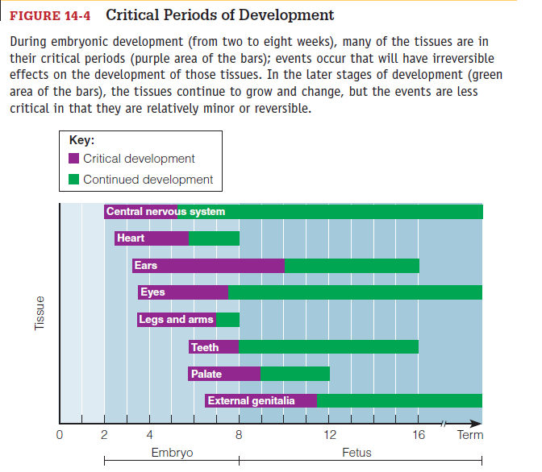

Slide 10
Neural Tube Defects
The two most common types of neural tube defects are anencephaly and spina bifida. In anencephaly, the upper end of the neural tube fails to close. Consequently, the brain is either missing or fails to develop. Pregnancies affected by anencephaly often end in miscarriage; infants born with anencephaly die shortly after birth.

Slide 11
The meninges membranes covering the spinal cord often protrude as a sac, which may rupture and lead to meningitis, a life threatening infection. Spina bifida is accompanied by varying degrees of paralysis, depending on the extent of the spinal cord damage.
Mild cases may not even be noticed, but severe cases lead to death. Common problems include clubfoot, dislocated hip, kidney disorders, curvature of the spine, muscle weakness, mental handicaps, and motor and sensory losses

Slide 12
Causes
A personal or family history of a pregnancy affected by a neural tube defect
Maternal diabetes
Maternal use of certain antiseizure medications
Mutations in folate-related enzymes
Maternal obesity
Folate supplementation reduces the risk.

Slide 13
Folate Supplementation
all women who are capable of becoming pregnant should consume 400 micrograms (0.4 milligrams) of folate daily.
A woman who has previously had an infant with a neural tube defect may be advised by her physician to take folate supplements in doses ten times larger(4 milligrams daily).
Because high doses of folate can mask the symptoms of the pernicious anemia of a vitamin B12 deficiency, quantities of 1 milligram or more require a prescription.
During pregnancy: 600 μg (0.6 mg)/day (Dietary Guidelines for Americans 2010)

Slide 14
Chronic Diseases
Poor maternal diet or health during pregnancy may alter the infant’s bodily functions such as blood pressure, cholesterol metabolism, and immune functions that influence disease development.
Malnutrition during the critical period of pancreatic cell growth provides an example of how type 2 diabetes may develop in adulthood.

Slide 15
Nutrition is a primary determinant of beta cell growth, and infants who have suffered prenatal malnutrition have significantly fewer beta cells than well-nourished infants. They are also more likely to be low-birth weight infants—and low birth weight and premature birth correlate with insulin resistance later in life.
the small mass of beta cells developed in times of under nutrition during fetal development may be insufficient in times of over nutrition during adulthood when the body needs more insulin.

Slide 16
Hypertension may develop from a similar scenario of inadequate growth during placental and gestational development followed by accelerated growth during early childhood: the small mass of kidney cells developed during malnutrition may be insufficient to handle the excessive demands of later life.
Low-birth weight infants who gain weight rapidly as young children are likely to develop hypertension and heart disease as adults.

Slide 17
Fetal Programming
Recent genetic research may help to explain the phenomenon of substances such as nutrients influencing the development of obesity and diseases later on in adulthood.
Because critical periods occur throughout pregnancy, a woman should continuously take good care of her health. That care should include achieving and maintaining a healthy body weight prior to pregnancy and gaining sufficient weight during pregnancy to support a healthy infant.

Slide 18
Maternal Weight
general, higher birth weights present fewer risks for infants.
Two characteristics of the mother’s weight influence an infant’s birth weight:
her weight prior to conception and her weight gain during pregnancy.

Slide 19
Weight prior to Conception
Underweight women tend to have smaller babies than heavier women, especially if she is malnourished or unable to gain sufficient weight during pregnancy. In addition, the rates of preterm births and infant deaths are higher for underweight women.
Overweight and Obesity: Obese women have an especially high risk of medical complications such as hypertension, gestational diabetes, and postpartum infections.

Slide 20
obese women are also more likely to have other complications of labor and delivery.
Overweight women have the lowest rate of low-birth weight infants. In fact, infants of overweight women are more likely to be born post term and to weigh more than 9 pounds.
Large newborns increase the likelihood of a difficult labor and delivery, birth trauma, and cesarean section
Obesity may double the risk for neural tube defects

Slide 21
Weight Gain during Pregnancy
The recommended gain for a woman who begins pregnancy at a healthy weight and is carrying a single fetus is 25 to 35 pounds.32 An underweight woman needs to gain between 28 and 40 pounds; and an overweight woman, between 15 and 25 pounds.
Appropriate weight gains help women limit weight retention after pregnancy and help their infants prevent obesity during childhood
Weight-Gain Patterns For the normal-weight woman, weight gain ideally follows a pattern of 3½ pounds during the first trimester and 1 pound per week thereafter

Slide 22
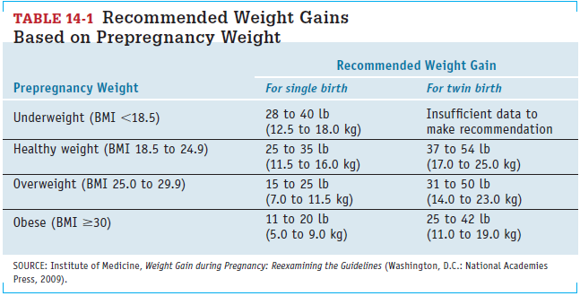

Slide 23
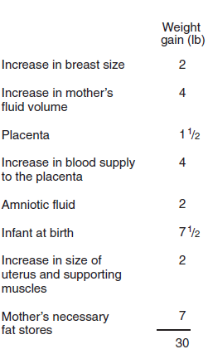
A large weight gain over a short time, however, indicates excessive fluid retention and may be the first sign of the serious medical complication preeclampsia.

Slide 24
Exercise during Pregnancy
An active, physically fit woman experiencing a normal pregnancy can continue to exercise throughout pregnancy, adjusting the duration and intensity of activity as the pregnancy progresses.
Staying active can improve fitness, prevent or manage gestational diabetes, facilitate labor, and reduce stress. Women who exercise during pregnancy report fewer discomforts throughout their pregnancies.

Slide 25
develops the strength and endurance a woman needs to carry the extra weight through pregnancy and to labor through an intense delivery.
It also maintains the habits that help a woman lose excess weight and get back into shape after the birth.
A pregnant woman should participate in “low-impact” activities and avoid sports in which she might fall or be hit by other people or objects

Slide 27
Nutrition during Pregnancy
Carbohydrate Ample carbohydrate (ideally, 175 grams or more per day and certainly no less than 135 grams) is necessary to fuel the fetal brain. Sufficient carbohydrate also ensures that the protein needed for growth will not be broken down and used to make glucose.

Slide 28
Protein The protein RDA for pregnancy is an additional 25 grams per day higher than for nonpregnant women. Pregnant women can easily meet their protein needs by selecting meats, milk products, and protein-containing plant foods such as legumes, whole grains, nuts, and seeds. Because use of high-protein supplements during pregnancy may be harmful to the infant’s development, it is discouraged.

Slide 29
Essential Fatty Acids The high nutrient requirements of pregnancy leave little room in the diet for excess fat, but the essential long-chain polyunsaturated fatty acids are particularly important to the growth and development of the fetus. The brain is largely made of lipid material, and it depends heavily on the long-chain omega-3 and omega-6 fatty acids for its growth, function, and structure.

Slide 30
Nutrients for Blood Production and Cell Growth
New cells are laid down at a tremendous pace as the fetus grows and develops. At the same time, the mother’s red blood cell mass expands. All nutrients are important in these processes, but for folate, vitamin B12, iron, and zinc, the needs are especially great due to their key roles in the synthesis of DNA and new cells.
It is best to obtain sufficient folate from a combination of supplements, fortified foods, and a diet that includes fruits, juices, green vegetables, and whole grains

Slide 31
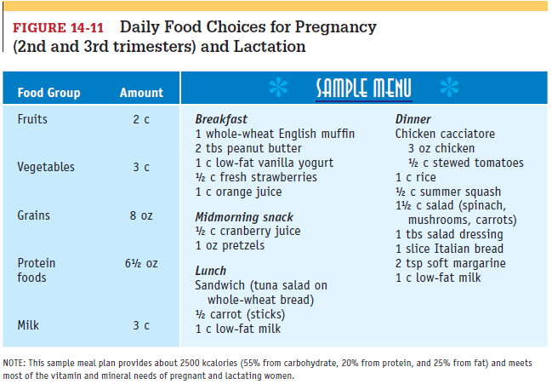

Slide 32
Pregnant women need iron to support their enlarged blood volume and to provide for placental and fetal needs.
The developing fetus draws on maternal iron stores to create sufficient stores of its own to last through the first four to six months after birth. Even women with inadequate iron stores transfer significant amounts of iron to the fetus, suggesting that the iron needs of the fetus have priority over those of the mother.

Slide 33
In addition, blood losses are inevitable at birth, especially during a cesarean section, and can further drain the mother’s supply
Few women enter pregnancy with adequate iron stores, so a daily iron supplement is recommended during the second and third trimesters for all pregnant women. For this reason, most prenatal supplements provide 30 to 60 milligrams of iron a day.

Slide 34
Zinc is required for DNA and RNA synthesis and thus for protein synthesis and cell development. Typical zinc intakes for pregnant women are lower than recommendations, but fortunately, zinc absorption increases when zinc intakes are low. Routine supplementation is not advised.
Women taking iron supplements (more than 30 milligrams per day), however, may need zinc supplementation because large doses of iron can interfere with the body’s absorption and use of zinc.

Slide 35
Nutrients for Bone Development
Vitamin D and the bone-building minerals calcium, phosphorus, magnesium, and fluoride are in great demand during pregnancy. Insufficient intakes may produce abnormal fetal bones and teeth.
During the last trimester, as the fetal bones begin to calcify, more than 300 milligrams a day are transferred to the fetus.

Slide 36
Recommendations to ensure an adequate calcium intake during pregnancy help to conserve maternal bones while supplying fetal needs
Because bones are still actively depositing minerals until about age 30, adequate calcium is especially important for young women.

Slide 37
Pregnant women younger than age 25 who receive less than 600 milligrams of dietary calcium daily need to increase their intake of milk, cheese, yogurt, and other calcium-rich foods. Alternatively, and less preferably, they may need a daily supplement of 600 milligrams of calcium.

Slide 38
